Slide 1
Talk to me! Ideas to get students talking
Spontaneous talk Role of the teacher
Primary Learning Network

Slide 2


Slide 3

¿Cuáles son las preguntas?
7. Sí, pero es un poco aburrido.
1. Me llamo Adam.
2. Tengo 15 años.
6. Sí, por supuesto. ¿Y tú?
3. En Cambourne.
5. Sí, me gusta mucho.
4. Sí.
Notes:
3

Slide 4
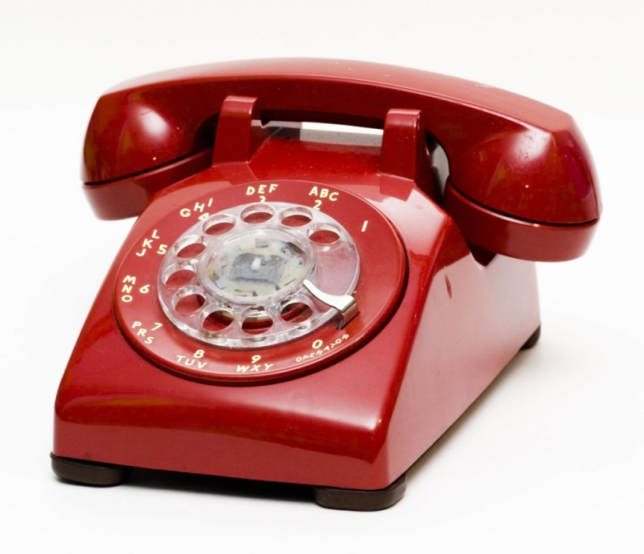
La conversación telefónica
A : Sondeo T Mobile, ¿Cómo te llamas?
B : Me llamo…
A : ¿ Cuántos años tienes?
B: Tengo…
A : ¿ Telefonas mucho?
B : Sí, 2 horas cada día.
A : ¿ Apellido por favor?
B : Es Fineberg
A : ¿ Cómo se escribe?
B : F – I – N – E – B – E – R – G
A : Gracias, adios.
B : Adios.

Slide 5
FIND SOMEONE WHO

Slide 6
fútbol
verde
hermana
enero
9 años

Slide 7
TARGET TALK

Slide 8

Quels sports aimes tu?
Your answer must contain EXACTLY 7 words!
¿Quels fruits aimes-tu?
Your answer must contain more than 9 words!
Notes:
The conditions or ‘targets’ can be many and varied. It ALMOST doesn’t matter as the point of putting a condition there is to cause students to think their sentences through carefully as they build them. It makes them much more aware of what they’re saying. And making a sentence of exactly 8 words will involve usually a very short clause with ‘weil’ or two clauses linked with ‘und’ or additional details like when and where. So they focus on different ways to make their sentences longer. It also works well to set >9 words or <5 words at times too.
8

Slide 9
GROUP TALK

Slide 10
En groupes
Questions to be answered in the task.
- Comment tu t’appelles?
- Quelle est ta couleur préférée?
-
-
In groups of 4, you are going to have one person asking the questions, one helper and one person answering

Slide 11



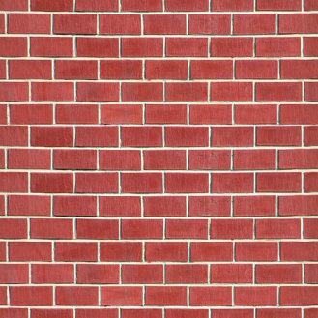
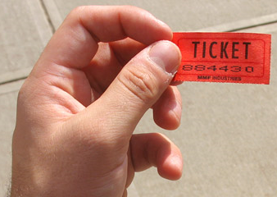
REWARDING SPONTANEITY

Slide 12

SPEND THE WORDS

Slide 13

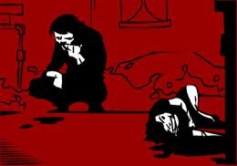
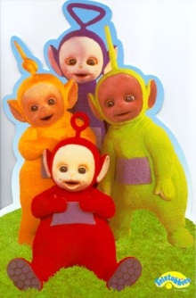
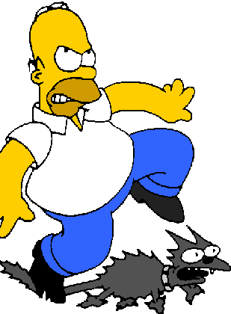

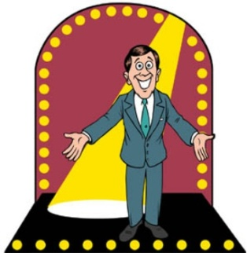
Mon anniversaire | Le chocolat | C’est délicieux
est | J’ai | Je joue au…
Parce que | football | C’est super
J’adore | ____(age) ans | Le ___(date) ___ (mois)

Slide 14

INCREASE THE SENTENCE IN JUST A MINUTE! (GROUPS)

Slide 15
J’ai un chat…
J’ai un chats vert…
J’ai un chats vert et noir…
J’ai un chats vert et noir, il aime le chocolat…
Slide from Neil Jones (with thanks!)

Slide 16
1
2
3
How many words?
4
5
6
Notes:
This is a whole class version of this activity, designed particularly with KS4 classes in mind. The idea would be that a general question is asked on a topic recently covered:
e.g. Que te gusta ver en la tele or Que deportes te gustan and a student would try to answer building in an example from each category – the teacher awards the ‘pieces of pie’ by clicking on the relevant sections according to the colour key as the student talks to involve all other students in what is essentially ‘modelling’ of extended answers. Students 2 – 6 who volunteer would also get to give their answers.
As a starter activity in whole teaching it takes approx 5 mins – obviously not all 6 x students need to be asked if a shorter activity is wanted.

