Slide 1
“Bridging the Gap:” Student Led Learning

Slide 2
HOW DO WE make the necessary and expected levels of progress?
We need to have;
Very high expectations
Systematic use of AFL
Interventions where necessary
Constructive Feedback
Effective use of TA
Imaginative use of ICT
Collaborative / peer learning

Slide 3
What does the research say?
“An outstanding lesson isn’t what the teacher does but what the learner learns”.
Ofsted wants to see teachers stepping back from being the expert and letting the students show their ability to learn independently

Slide 4
“sage off the stage”
Context: Increasing focus on mixed ability teaching
Provides effective peer support
Encourages students to aspire to more

Slide 5
Where do we start?
At the beginning of any unit you need to share the success criteria with students so they understand what they are working towards.
Students need to understand exactly what they need to do to achieve.
This should be referred to throughout the unit.

Slide 6
Unit of Work: | Assignment title:
Success Criteria | Peer/self assessment
I have researched and planned my presentation carefully. I have structured my talk clearly, using other media to support my talk. I spoke clearly and communicated well to my audience. I didn’t just read notes out. I listened carefully to others and asked questions and contributed to discussion I have written an evaluation of my presentation | WWW EBI
On target? | Teacher Comment
T-/T/T+
New learning goals
Modelled on GCSE criteria.
Both preparing and stretching students
Year 9: Speaking and Listening Assessment on Gothic Horror

Slide 7
Year 9: Interactive presentations on Gothic Horror
Students discuss and comment on the assessment task.
They generate ideas in groups about what their area of research.
During feedback students share their ideas and are asked challenging questions by their peers to guide and develop their presentations

Slide 8
Incorporate support from peers
For homework students work independently to develop their plan.
Over the next few lessons students share their ideas and the work they have produced so far.
This enables you to model to the others what you expect by commenting on the strengths but also noting the areas for improvement.

Slide 9
Incorporate support from home
The students’ research and the completion of the task itself is taking place at home (Dependent on ICT availability)
This promotes independent learning
Encourage students to show their work to siblings or parents to increase a sense of pride and motivation

Slide 10
Teacher support
Have high expectations
Give the students a reasonable amount of time to complete the task.
Develop responsibility by encouraging students to email/show you with their work so far so that you can further advise with targets
Refer to this in class so that complacent students will become competitive and keen to receive extra guidance

Slide 11
How do we ensure learning takes place during presentations?
Encourage students to be ‘teachers’
Use your model of learning
They should present in a way that is engaging but they should also include tasks for students to complete

Slide 12
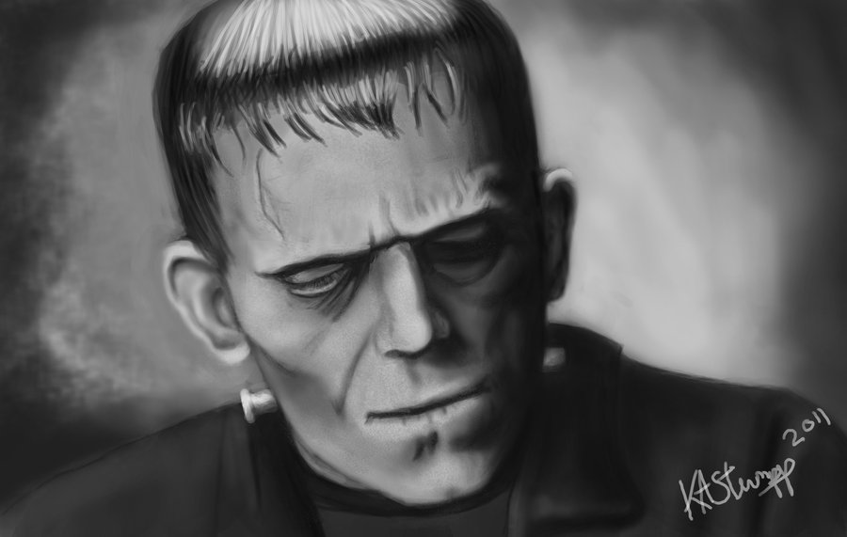
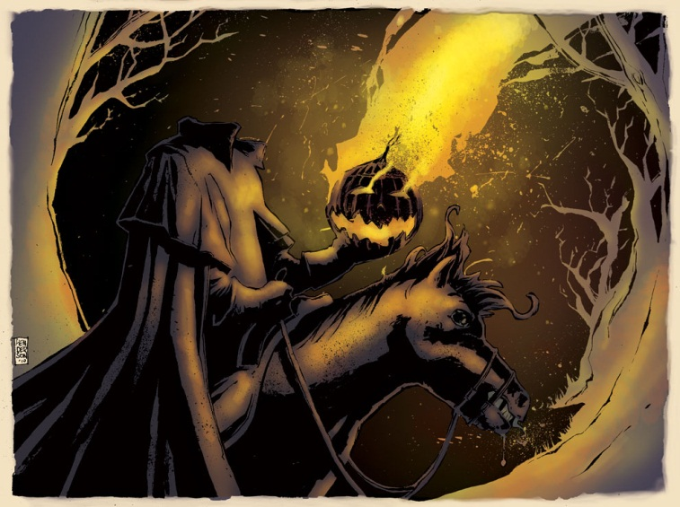
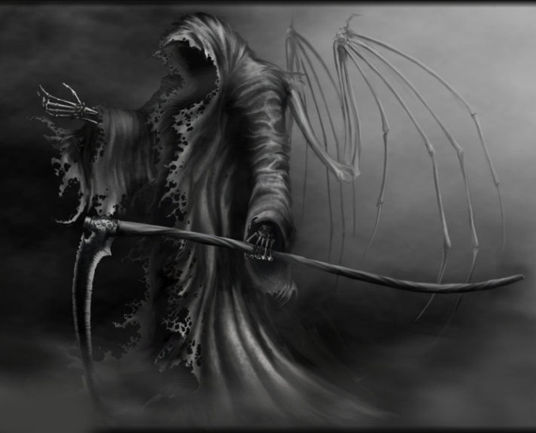
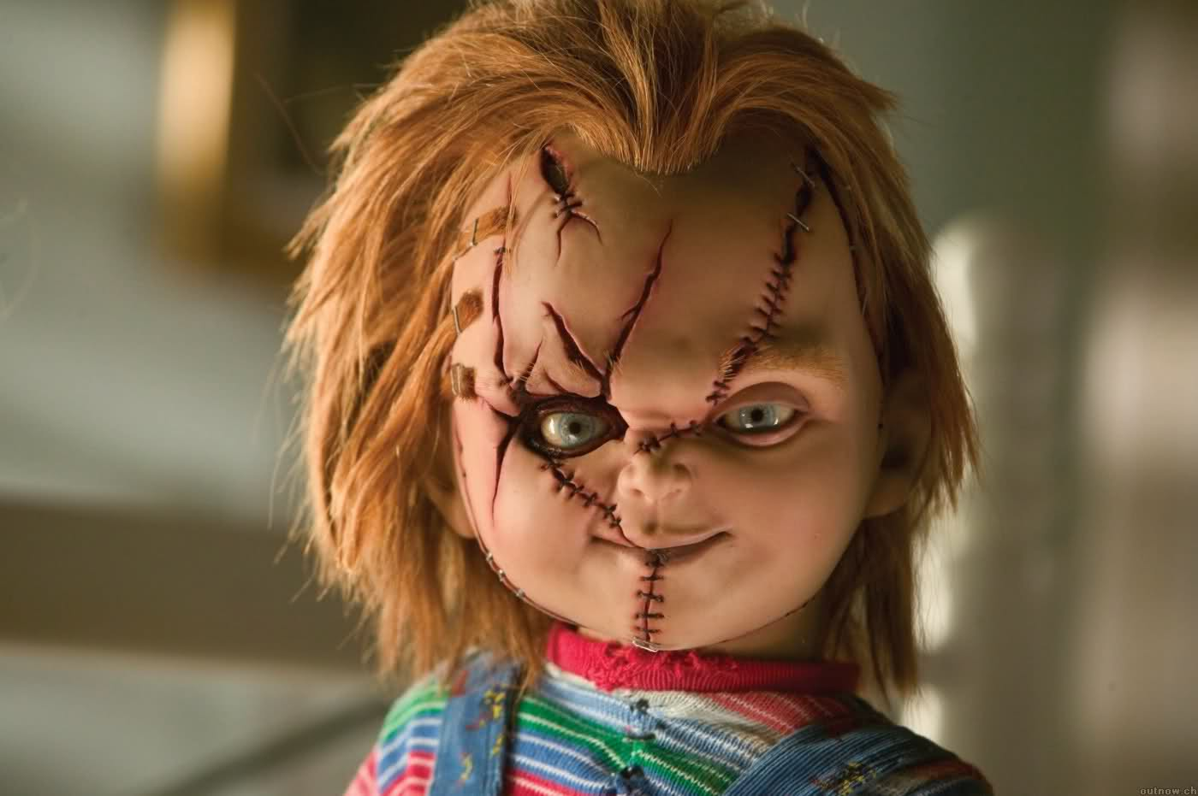
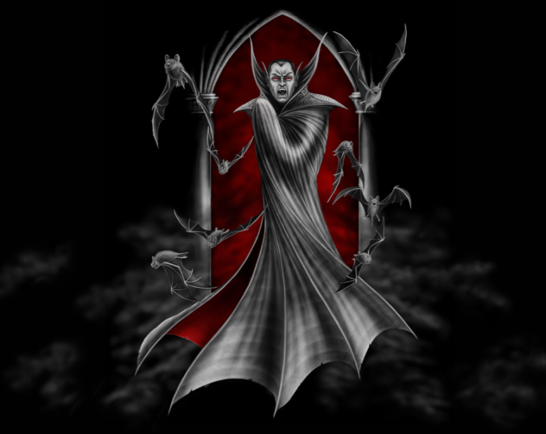
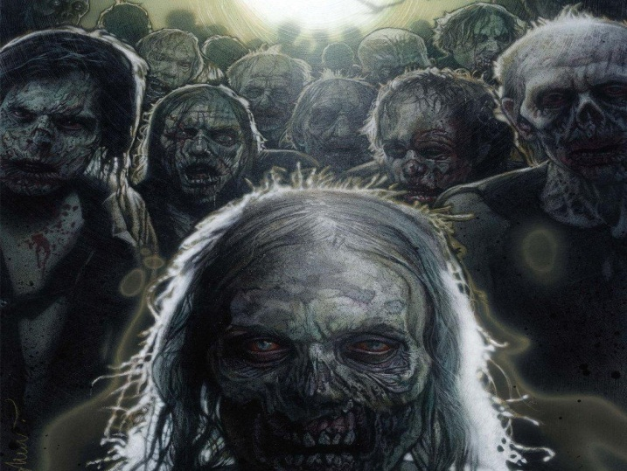
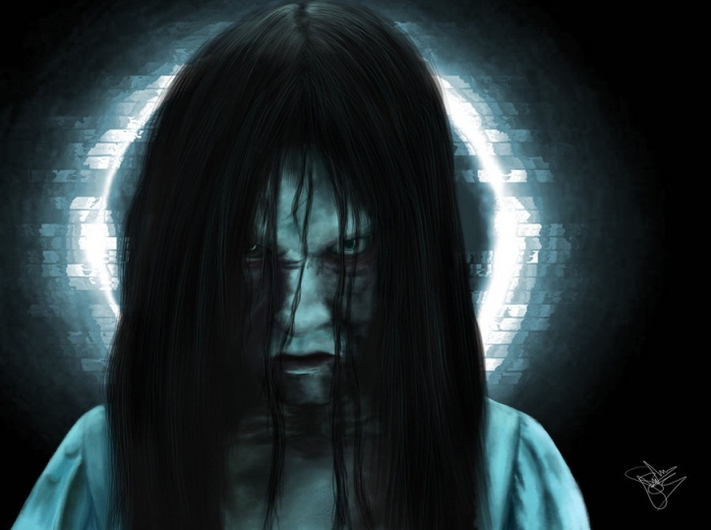
The monsters that
make horror: What do they have in common?

Slide 13
Guess the monster. Or film title.
(No prizes)
1
2
3
4
5

Slide 14
Stress the need to engage students How does this image link to gothic horror?

Slide 15
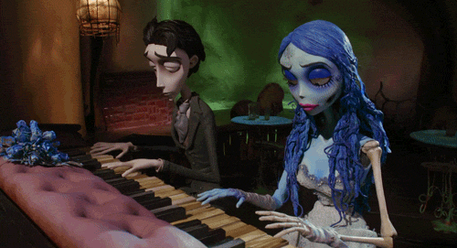
http://www.youtube.com/watch?v=TNtGXRX_QTs

Slide 16
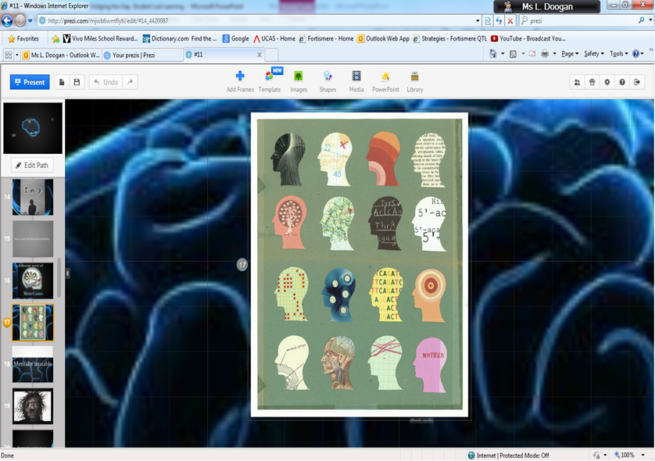
Imaginative use of ict
Encourage students to use ICT to support their presentation
This is an area in which all students feel confident
It is a resource that students can use to enhance their learning
New exciting software like Prezi
http://prezi.com/u_8_iddmpp2z/bollywood/

Slide 17
Use of pathetic fallacy in gothic horror
Woman in Black: “it was a yellow fog, a filthy evil smelling fog that choked and blinded, smeared and stained.”
The fog is described using pathetic fallacy. In the quote above, the fog suggests that Arthur Kipps' vision of the future is blurred and little does he know what might happen when he sets off for Eel Marsh House. The repetition of the word "fog" suggests it is ubiquitous. The word "choke" personifies the fog and makes it appear as harmful. The specific adjectives appeal to the senses of smell, sight and taste and dynamic verbs help to convey the idea that fog is evil.

Slide 18
Peer Assessment
To further stretch students make time for a question and answer session after the presentation.
Support students with question stems. Stress that every student has to ask at least one question
Also peer-assessment with structured comments that link back to the success criteria
What went well?
Even better if…? | Achieved in final assessment?
:

Slide 19
Assessment for learning
After peer-assessment the teacher then comments on the students work.
Avoid grades or levels as this encourages a ‘fixed’ rather than a ‘growth’ mind set.
Better to identify how the student made progress and what they need to do to improve.

Slide 20
Reflection on the learning
It is crucial that students have time to reflect on their work and the comments they receive.
They must do something with these comments.
Write a reflective paragraph on what they learned or re-do part of the task they found difficult.
Set an action plan for how they are going to achieve their targets

Slide 21
Should we entrust all students to lead the learning?
Yes, this works particularly well across all key stages
However crucial to this is that each member has their own role and responsibility within the group
Students feel included and supported by the experience of being part of a team.

Slide 22
Sixth Form

Slide 23
For example
These Year 12 literature students were presenting to the class on a poem by W. B. Yeats that we have not yet studied.
Each student is responsible for delivering ideas and analysis about different sections of the poem.
They are also responsible for designing activities
They use techniques I have modelled to them

Slide 24
How it works in practice…
Introducing and setting up the task
http://www.youtube.com/watch?v=F5BXg_Ur7wA&safe=active
Managing and developing discussion for learning
http://www.youtube.com/watch?v=7Sr6EXkvDZg&safe=active
Handling confusion and getting there in the end
http://www.youtube.com/watch?v=vUGevTGYF2Y&safe=active

Slide 25
Strategies to bridge the gap
Success criteria shared as a starting point
Keep referring back to the success criteria
Get students to constantly re-assess where there are at different stages in the project
Collaborative work with distinct roles and responsibilities
Imaginative use of ICT: moving images, sound files.
Team teach with support staff
Provide students with resources and links to assist their research.
Share model examples
Hands down policy.
Student feedback to improve future projects

Slide 26
Concluding comments
Ultimately students rise to the responsibility of teaching their peers.
They have a role and feel a sense of duty to support their group
They also have ownership of one particular thing and this gives them confidence
Take Pride in presenting to others

Slide 27
Pupil Feedback
“I felt proud because I was telling the class things they didn’t know”
“It meant you really had to become an expert because it was your responsibility to teach the topic”
“It was really helpful to be supported by my group members”
“I feel like I have really learnt something”

Slide 28
Above all
‘Ever tried? Ever failed? No matter. Try again. Fail better.’
Most important is the need to create a safe and supportive environment in which students feel comfortable in taking risks.

Slide 29
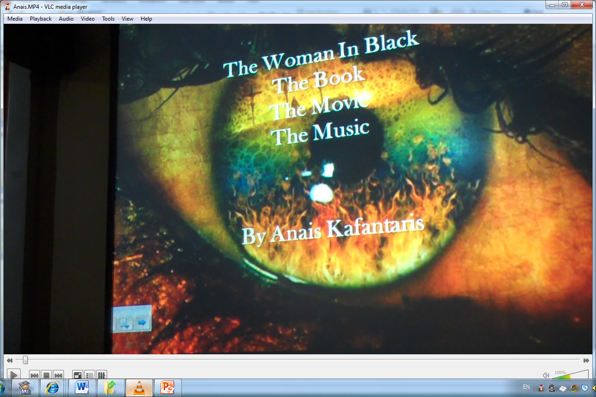
Inclusion and support
Anais suffers from a severe stammer and was terrified about the presentation.
With the support of her peers Anais successfully led the learning
http://www.youtube.com/watch?v=B5dwaUZ8VJI&safe=active

